Slide 1
Product Backorder
CAPSTONE FINAL PROJECT

Slide 2
Introduction
Part backorders is a common supply chain problem.
Goal : Identify parts at risk of backorder before the event occurs so the business has time to react.
The data was taken as weekly snapshots at the start of each week.

Slide 3
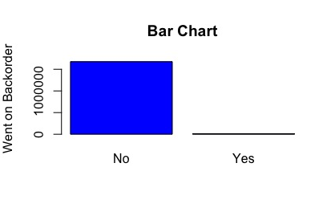
Data
Dataset was already divided into training and test sets
Replaced missing values by -99
Created dummy variables by changing No/Yes to 0/1
Went on backorder : Yes: 1676567 or 99.7% and NO: 11293 or 0.7%
Data is Imbalanced

Slide 4
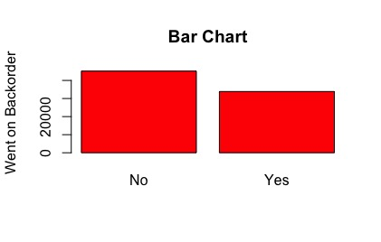
Analysis and methods
With imbalanced data sets, an algorithm doesn’t get the necessary information about the minority class to make an accurate prediction
SMOTE: Synthetic Minority Over-sampling Technique to balance the data

Slide 5
Results
Linear regression: Accuracy: 82.63% / AUC: 50.55%
Cart Regression Tree : Accuracy: 90.95% / AUC: 81.95%
Random Forest : Accuracy: 90.38% / AUC: 81.94%

Slide 6
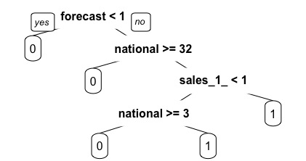
Cart Regression Tree

Slide 7
Recommendation
If the forecast sales for 3 months is above 1, the current inventory level for the part is less than 33 and the sales quantity for the prior 1 month time period is more than 1, the part will go on backorder. The company should avoid having these 3 conditions happening simultaneously; otherwise the part will go on backorder.
If the forecast sales for 3 months is above 1, the current inventory level for the part is less than 2 and the sales quantity for the prior 1 month time period is less than 1, the part will go on backorder. As soon as these conditions are observed the company should restock to avoid a potential backorder.

Slide 8
CONCLUSION
The recommendations to avoid a part backorder were based on our regression tree model, which is our best model with 90.95% accuracy. The recommendations listed above will help the company predict a part backorder before it occurs so the company could take the appropriate action to avoid it.

